Slide 1
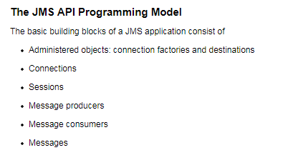
JMS API Programming Model
JMS Administered Objects:
Two parts of a JMS application, destinations and connection factories, are best maintained administratively rather than programmatically.
The technology underlying these objects is likely to be very different from one implementation of the JMS API to another. Therefore, the management of these objects belongs with other administrative tasks that vary from provider to provider.
JMS clients access these objects through interfaces that are portable, so a client application can run with little or no change on more than one implementation of the JMS API. Ordinarily, an administrator configures administered objects in a JNDI namespace, and JMS clients then access them by using resource injection.

Slide 2
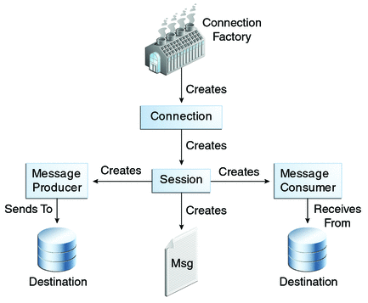
JMS API Programming Model
Java Messaging Service (JMS) is all about applications communicating using standard based messaging. With JMS, applications communicates with each other by sending and receiving messages.
There are various JMS providers which implements JMS standard and provides additional implementation-specific functionalities. Apache ActiveMQ , IBM Websphere MQ , JBoss hornetQ to name a few
JMS Connection Factories: A connection factory is the object a client uses to create a connection to a provider. A connection factory encapsulates a set of connection configuration parameters that has been defined by an administrator. Each connection factory is an instance of the ConnectionFactory, QueueConnectionFactory, or TopicConnectionFactory interface.
JMS Destinations: A destination is the object a client uses to specify the target of messages it produces and the source of messages it consumes. There are two types of destination in JMS: queues and topics.
JMS Connections: A connection encapsulates a virtual connection with a JMS provider. A connection could represent an open TCP/IP socket between a client and a provider service daemon. You use a connection to create one or more sessions.

Slide 3
JMS API Programming Model
JMS Sessions: A session is a single-threaded context for producing and consuming messages. You use sessions to create the following:
Message producers
Message consumers
Messages
Queue browsers
Temporary queues and topics
JMS Message Producers: A message producer is an object that is created by a session and used for sending messages to a destination. It implements the MessageProducer interface.
JMS Message Consumers: A message consumer is an object that is created by a session and used for receiving messages sent to a destination. It implements the MessageConsumer interface.
JMS Message Listeners: A message listener is an object that acts as an asynchronous event handler for messages. This object implements the MessageListener interface, which contains one method, onMessage. In the onMessage method, you define the actions to be taken when a message arrives.You register the message listener with a specific MessageConsumer by using the setMessageListener method.

Slide 4
JMS API Programming Model
JMS Message Selectors: If your messaging application needs to filter the messages it receives, you can use a JMS API message selector, which allows a message consumer to specify the messages it is interested in. Message selectors assign the work of filtering messages to the JMS provider rather than to the application.
JMS Messages: The ultimate purpose of a JMS application is to produce and to consume messages that can then be used by other software applications. JMS messages have a basic format that is simple but highly flexible, allowing you to create messages that match formats used by non-JMS applications on heterogeneous platforms.
JMS Queue Browsers: You can create a QueueBrowser object to inspect the messages in a queue. Messages sent to a queue remain in the queue until the message consumer for that queue consumes them. Therefore, the JMS API provides an object that allows you to browse the messages in the queue and display the header values for each message.
JMS Exception Handling: The root class for exceptions thrown by JMS API methods is JMSException. Catching JMSException provides a generic way of handling all exceptions related to the JMS API.

Slide 5
JMS API Programming Model
Persistent/Non-persistent Messages [Aka Delivery Mode : for Messages]
Delivery Mode refers to persistence/non-persistence of messages which can be specified on MessageProducer level as well as on individual message level.
Default delivery mode is PERSISTENT, means messages will be stored on disk/database until it is consumed by a consumer, and will survive a broker restart.
When using non-persistent delivery, if you kill a broker then you will lose all in-transit messages.
Durable / Non-durable subscriptions[for Topics]
Subscription refers to subscription on a topic.
With a durable subscription, if the subscriber [which has subscribed for message on a topic] is down for some time, once it comes up, it will receive all the messages sent for it(including the ones sent when it was down).
With Non-durable subscription, a subscriber will receive only the messages when it was connected to topic (will loose all the ones sent when it was down). Note that this is not applicable for Queue’s as they can be considered always durable [only one consumer, and it will always receive the message destined for it in queue].

